Slide 1



AstroSage Analysis
Pooja Gurumurti Tamragouri

Slide 2
Agenda
Introduction
Analysis
Areas of focus
Dashboard
Summary

Slide 3
Problem Statement & Data Overview
You are tasked with optimizing the call center operations for AstroSage, which has received a 1 crore investment. The goal is to determine how to allocate this investment to maximize operational efficiency, customer satisfaction, and profitability. This project will involve analyzing historical call data, performance metrics, and market trends to make informed decisions.
Data Overview:
User Registration and Profile Setup: Users sign up on the AstroSage platform and create a profile, providing basic information such as their birth details and preferred astrological services.
Select Astrologer or Service: Users browse through the list of astrologers or services available on AstroSage. They can choose based on the astrologer’s expertise, ratings, and availability.
Book a Consultation: Once the user selects an astrologer or service, they can schedule a consultation via chat, call, or video, based on their convenience.
Receive Personalized Guidance: During the session, users receive personalized astrological guidance from the astrologer. This could include horoscopes, Vedic astrology insights, or numerological advice.
Post-Consultation Services: Users can review the astrologer and save the session details. AstroSage also provides follow-up services such as detailed reports or further consultations based on the user’s needs

Slide 4
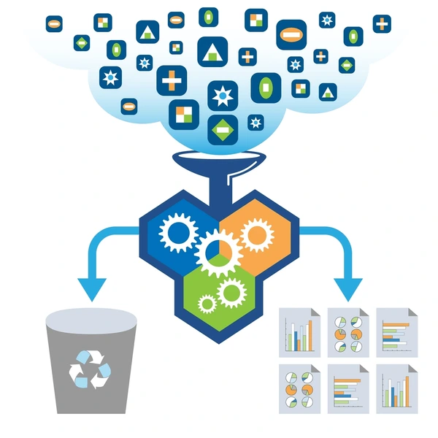
Data Cleaning and Analysis:
Leveraged a variety of functions, including LEFT, RIGHT, TEXT, INT, DATEVALUE, TIMEVALUE, COUNTIF, ISBLANK,SUBSTITUTE, and DATE for data cleaning purpose.
Utilized SUM,COUNTIF, COUNTUNIQUE, MAX, MIN for calculation and searching purpose.
Additionally, employed multiple Pivot Tables to distill and summarize critical metrics, providing actionable insights
Conducted trend analysis over time-series data and implemented dynamic charts alongside slicers to facilitate a more granular exploration of the dataset and foster deeper analytical insights.

Slide 5

Data cleaning and preprocessing:
Removed a few irrelevant columns:- timeDuration(some irrelevant data as per the description provided in the presentation), isWhiteListUser and queue columns are
irrelevant (they have single values).
I have cleaned and extracted the data over the following columns: chatStatus, createdAT, updatedAt, chatStartTime,chatEndTime and guruName.
Use of Data:
Upon thorough cleaning and preprocessing of the data, I have conducted a comprehensive evaluation of
AstroSage’s business model.
The analysis of data will provide the area of improvement where funds need to be infused.

Slide 6
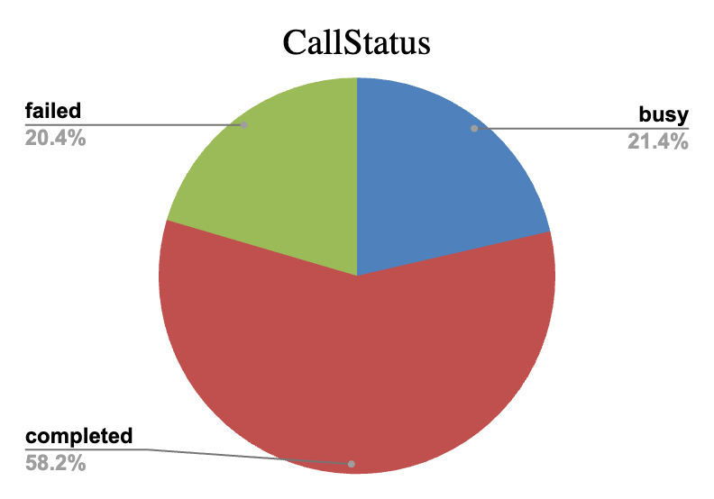
Call Status
The call status data indicates a total of 1,270 busy calls, reflecting a significant number of concurrent communications.
With 3,453 completed calls, the overall success rate is strong, suggesting effective handling of calls.
However, the 1,214 failed calls point to potential issues that need addressing, such as connectivity problems or user experience hurdles.
Overall, while the system demonstrates a healthy completion rate, the high number of failed calls warrants further investigation to enhance service quality.

Slide 7
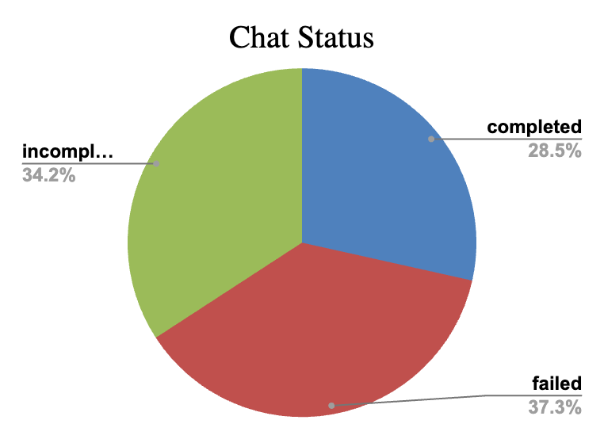
Chat Status
The chat status report reveals that there were 5,535 completed chats, showcasing a reasonable level of successful interactions.
However, the number of failed chats stands at 7,255, indicating a significant challenge in maintaining effective communication.
Additionally, there were 6,641 incomplete chats, suggesting that many conversations did not reach a resolution, highlighting areas for improvement in the chat support process.

Slide 8
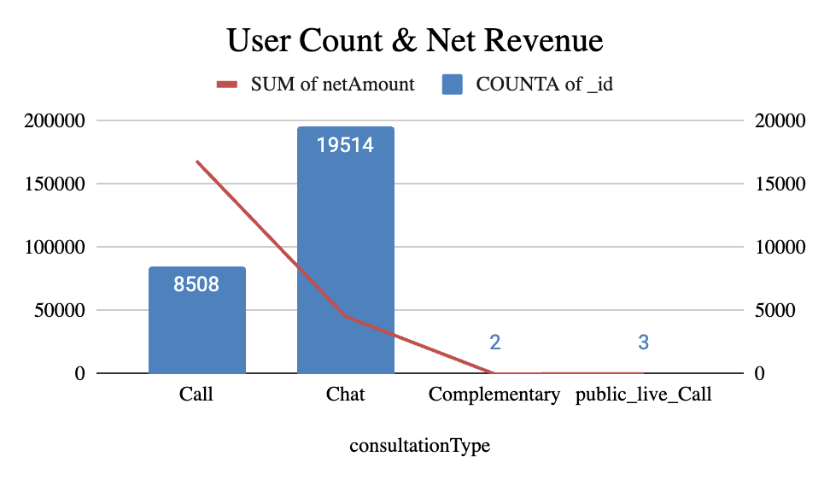
Revenue Analysis
Number of users in Chat is more compared to the Call, but the revenue generated by call is 78.8% v/s 21.2% over chat. By understanding the substantial difference of Sales between indicates that Customers have a strong preference for “Call” over “Chat”.
This indicates while chat is a popular medium, it isn’t contributing as much revenue as calls do.
Out of 3629 callers, 2352 are repeat callers which indicates that a large portion of customers have called multiple times, which indicates that customer queries are not resolved or agent/guru were not able to solve the customer problem on first contact.
Since Call generates more revenue than the Chat , Company can promote Call consultations so that it maximizes the revenue of the Company.

Slide 9
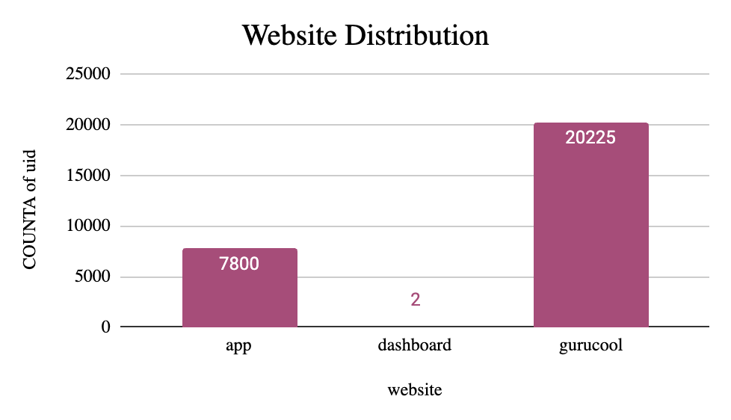
Website Distribution
Dominant Platform: The gurucool platform leads significantly with 20,225 unique users. This suggests it is the most popular or effective website among the options listed, indicating a strong user base and potentially effective engagement strategies.
High Engagement on App: The app has 7,800 unique users, which, while substantial, is significantly lower than gurucool. This suggests that while the app is used, it may not be fully capitalizing on the potential audience or user engagement compared to the website.
Underutilization of Dashboard: The dashboard shows minimal engagement with only 2 unique users. This could indicate that this feature is either under promoted, underdeveloped, or not aligned with user needs, suggesting an opportunity for improvement.

Slide 10
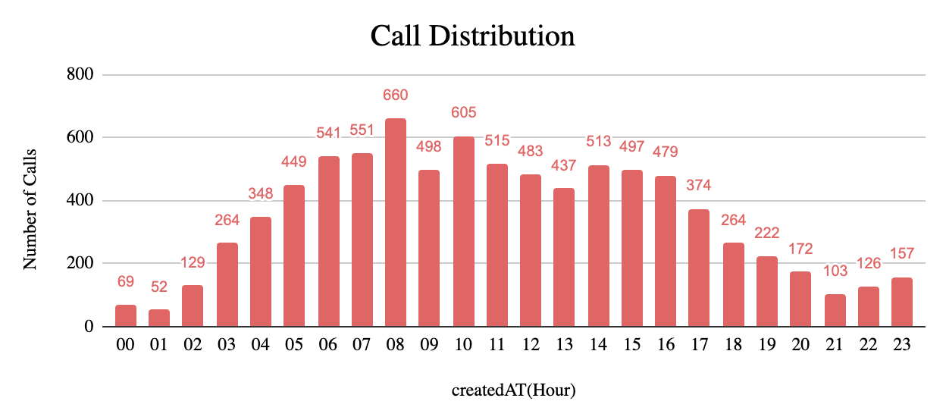
Call Distribution
Peak Usage in Early Morning: The highest volume of calls occurs between 5 AM and 8 AM, with 449 calls at 5 AM and 660 at 8 AM. This suggests that users are most active in the early morning hours, potentially indicating a preference for morning consultations.
Evaluate Evening Strategy: Consider strategies to boost engagement in the evening hours, such as promotions or targeted communications that might attract users to call during that time.
Midday Promotions: Since midday hours maintain stable engagement, promotional activities could be aligned to maximize user interaction during this time.
Late-Night Engagement Exploration: Investigate the motivations behind late-night calls to see if there are specific needs that can be catered to, potentially leading to the development of tailored services or marketing efforts.

Slide 11
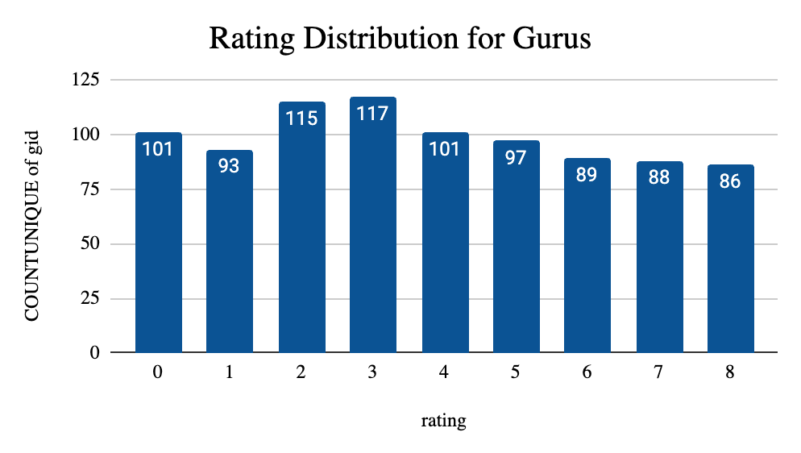
Rating Distribution for Gurus
Most Common Ratings: The ratings are relatively spread out, but the most frequently given ratings are 2 and 3, with 115 and 117 unique gurus receiving these ratings, respectively. This suggests that many gurus are perceived as average or slightly above average by users.
Declining Trend: There’s a noticeable decline in the number of unique gurus receiving higher ratings (6 through 8), with 89 for a rating of 6 and 86 for 8. This trend suggests that as the ratings increase, fewer gurus are meeting the higher standards expected by users.
Targeted Improvement Programs: Focus on those receiving low ratings (0 and 1) to identify specific areas for improvement, such as training or resource allocation.

Slide 12
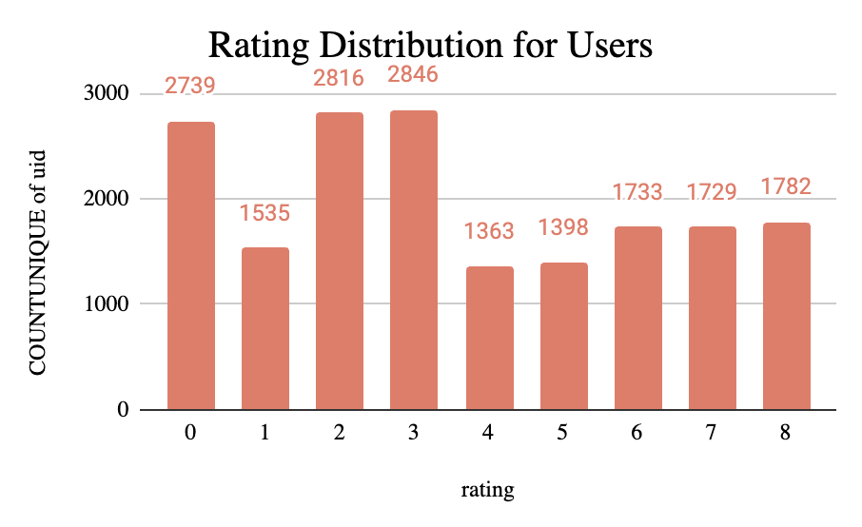
Rating Distribution for Users
High Frequency of Low Ratings: The 0 rating has the highest count, with 2,739 unique users. This indicates a significant level of dissatisfaction among users, suggesting that many feel their experiences did not meet expectations.
Enhance User Engagement: Develop strategies to actively engage users who rated their experiences as average (2 and 3) to gather feedback and work on increasing their satisfaction levels.
Quality Improvement Programs: Implement training and quality assurance programs aimed at addressing the factors contributing to low ratings. This could help elevate overall user satisfaction.
Monitor Trends Over Time: Continuously track rating distributions to evaluate the effectiveness of improvement initiatives and adjust strategies based on user feedback and changing trends.

Slide 13
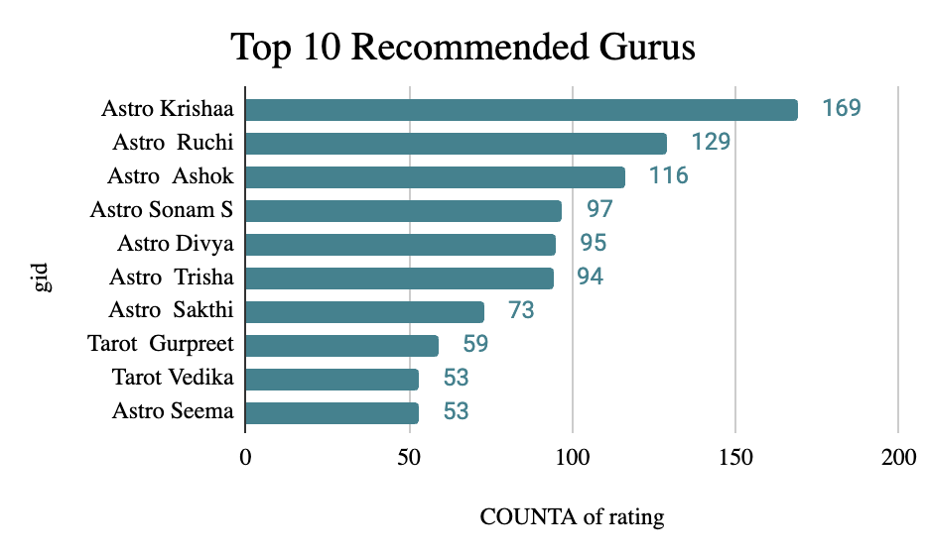
Rating Distribution for Gurus
Top Guru Performance: Guru 287 stands out as the top performer with 169 ratings, indicating a strong presence and likely a high level of user engagement or satisfaction. This suggests that they may be effectively meeting user needs.
Consistent Ratings Across Gurus: The next top gurus, 75 and 274, have 129 and 116 ratings respectively. The relatively close counts indicate that several gurus are performing well, suggesting a competitive landscape among the top-rated individuals.
Declining Rating Counts: There is a noticeable drop in ratings as we move down the list. The 10th guru, 291, has only 53 ratings. This declining trend implies that while there are a few standout gurus, many are not as highly rated or recommended by users.

Slide 14
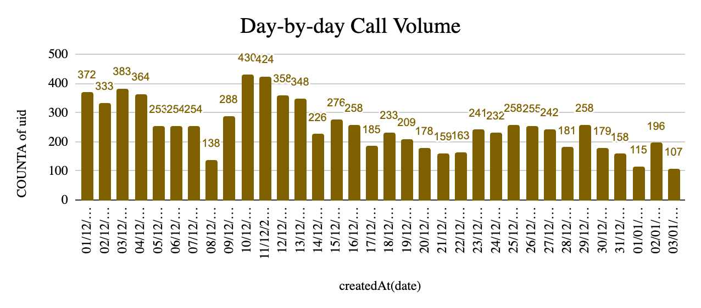
Day-by-day Call Volume
The user activity data from December 1, 2023, to January 3, 2024, reveals significant fluctuations in call volume. Peaks occurred on December 10 and 11, with 430 and 424 calls respectively, while New Year's Day saw the lowest volume at 115 calls. Overall, the data suggests stable user engagement with notable drops during the holiday period, highlighting the impact of external events on communication activity.

Slide 15
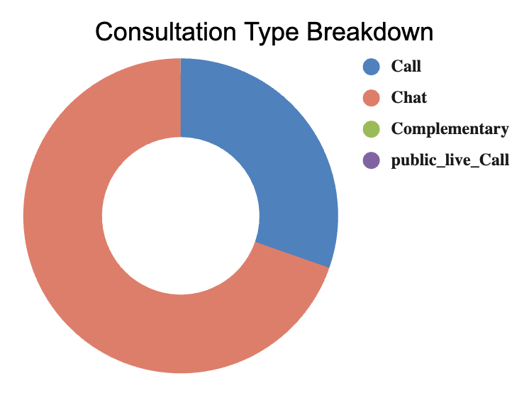
Consultation Type Breakdown
Volume of Interactions: The Call consultation type dominates with 8,508 interactions, significantly outpacing the Chat type, which has 19,514 interactions.
Revenue Contribution: Despite the higher number of Calls, Chat consultations generate a substantial revenue of $45,494.68, while Calls bring in $168,442.04. This suggests that Calls are not only more frequent but also more lucrative per interaction.
Focus on Call Optimization: Given that Calls yield the highest revenue, further enhancing the quality of Call consultations could lead to increased customer satisfaction and potentially higher revenues.
Leverage Chat for Upselling: Since Chats have high volume but low revenue, consider strategies to upsell or cross-sell during these interactions to increase the average transaction value..

Slide 16
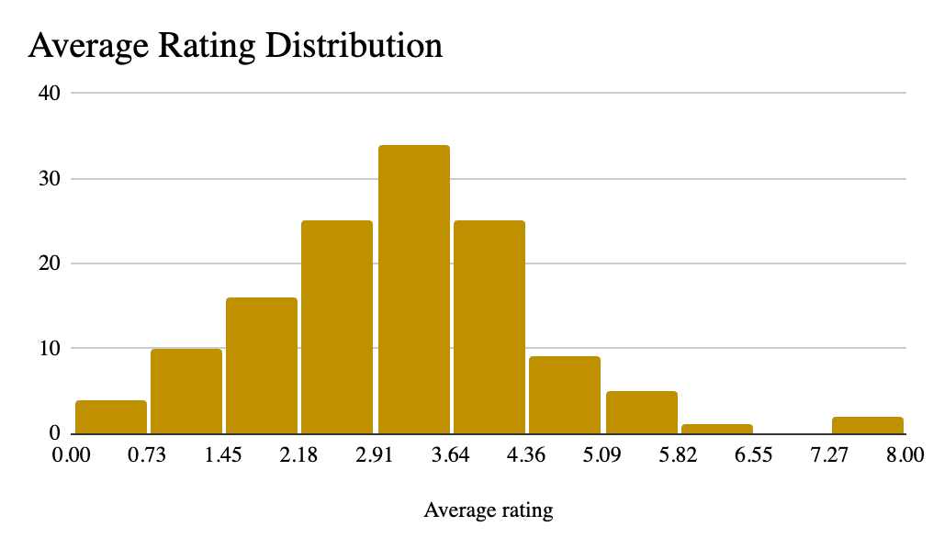
Average Rating Distribution
The “Average rating Distribution” chart is being derived from this pivot table which indicates that a major portion lies below 3.64 out of 8 maximum rating, suggesting that the user experience is low.
Some agents earn substantial amounts but they have low ratings, while others have high ratings but lower earnings.
The grand total shows a low average rating of 2.93. This suggests that overall customer satisfaction is below average.
Hiring more agents might seem like a solution, but the current data suggests performance issues that may not be solved simply by increasing the number of agents. Instead, focus on optimizing the performance of the current workforce.

Slide 17
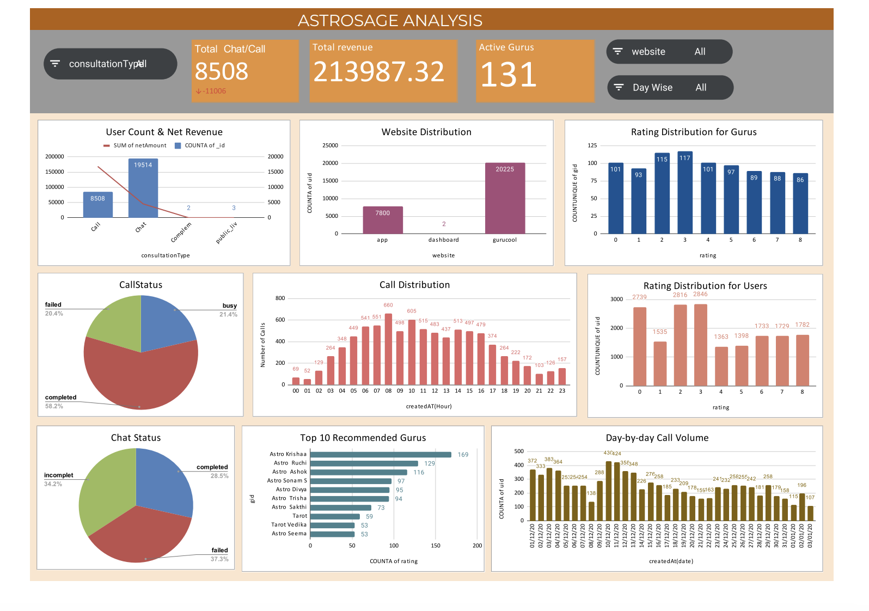
Analytical Dashboard

Slide 18

Recommendations:
Data-Driven Decision Making:
Implement Advanced Analytics Tools: Utilize software that can analyze large datasets to identify trends and inefficiencies. Tools like Tableau or Power BI can visualize data effectively.
Regular Reporting Schedule: Establish a routine (monthly or quarterly) for reviewing operational data and KPIs to ensure timely adjustments.
Cross-Department Collaboration: Encourage collaboration between departments (e.g., marketing, sales, operations) to share insights derived from data analysis.
Customer Feedback Integration:
Create Feedback Loops: Develop multiple channels for customer feedback (surveys, social media, direct communication) and regularly review this data.
Segment Customer Feedback: Analyze feedback by customer segments to understand diverse needs and tailor improvements accordingly.
Act on Feedback: Establish a process for prioritizing and implementing changes based on customer feedback, and communicate these changes to customers to enhance trust.

Slide 19
Performance Metrics Tracking
Develop Comprehensive Dashboards: Create dashboards that compile relevant KPIs in real time, making it easy for teams to monitor progress and outcomes.
Set Clear KPIs: Define specific, measurable KPIs for each initiative, such as Net Promoter Score (NPS) for customer satisfaction and operational efficiency ratios for productivity.
Regular Review Meetings: Hold regular meetings to discuss performance metrics, allowing teams to adjust strategies quickly based on data insights.
Scalable Solutions
Adopt Cloud-Based Solutions: Invest in cloud technologies that allow for easy scaling and integration as your business grows (e.g., CRM systems like Salesforce).
Focus on Modular Systems: Choose software and technologies that allow for modular additions, enabling incremental upgrades without overhauling existing systems.
Plan for Future Growth: Incorporate scalability into your investment strategy by forecasting future needs based on growth projections and market trends.

Slide 20

Summary
High Chat Activity, Low Revenue: Despite the high volume of chat interactions, these sessions are not being effectively converted into revenue opportunities.
Uneven Workload Distribution: The existing technology fails to evenly distribute call volumes, resulting in agent burnout and variability in service quality.
Training Shortcomings: There is an opportunity to enhance customer interactions and drive revenue through targeted training initiatives aimed at improving agent performance.
Revenue Enhancement: Investing in better training for agents and upgrading technology will enhance the monetization of high-engagement channels like chat, driving revenue growth.
Customer Experience Improvement: Strategic investments in both technology and training will lead to substantial improvements in customer service, thereby increasing satisfaction and fostering higher retention rates.
By adopting these data-driven strategies, AstroSage can achieve a marked improvement in operational efficiency and customer satisfaction, paving the way for sustained growth and a stronger competitive position in the market.

Slide 21




Thank you
Pooja Gurumurti Tamragouri
poojagurumurti@gmail.com

